Slide 1
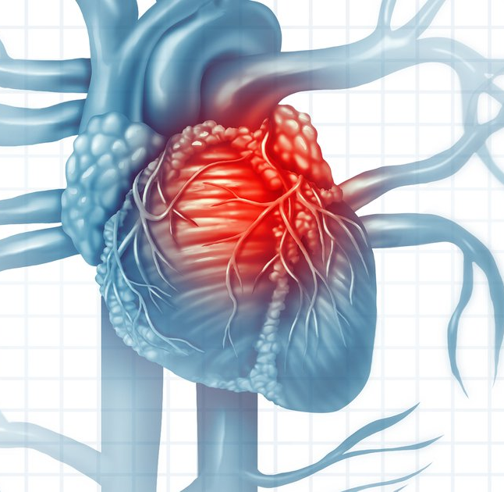
Heart Disease Prediction - Logistic Regression

Slide 2
AIM:
My end of goal is to predict the risk of patient developing a cardiovascular disease.
I am going to being using model to test the importance of each feature.

Slide 3
Contents
1. Basic Data Analysis
2. Analyzing Features using Visualizations
3. Cleaning the dataset
4. Standardization
5. Normalization
6. Feature selection
7. Applying models
8.Conclusion
9. Will you develop CHD?

Slide 4
Basic Data Analysis
Before anything is done to the data, we must take a look at the features and values included.
Here are what all the features are described as:
male: 0 = Female; 1 = Male
age: Age at exam time.
education: 1 = Some High School; 2 = High School or GED; 3 = Some College or Vocational School; 4 = college
currentSmoker: 0 = nonsmoker; 1 = smoker
cigsPerDay: number of cigarettes smoked per day (estimated average)
BPMeds: 0 = Not on Blood Pressure medications; 1 = Is on Blood Pressure medications
prevalentStroke
prevalentHyp
diabetes: 0 = No; 1 = Yes
totChol: mg/dL
sysBP: mmHg
diaBP: mmHg
BMI: Body Mass Index calculated as: Weight (kg) / Height(meter-squared)
heartRate: Beats/Min (Ventricular)
glucose: mg/dL
TenYearCHD: If the patient has had congestive heart failure in the last ten years. This will be what my models will be predicting.

Slide 5
There are 16 features in total. I predict that the gender, total cholesterol, TenYearCHD and age will be the most useful in predicting if a person has/will have congestive heart failure.

Slide 6
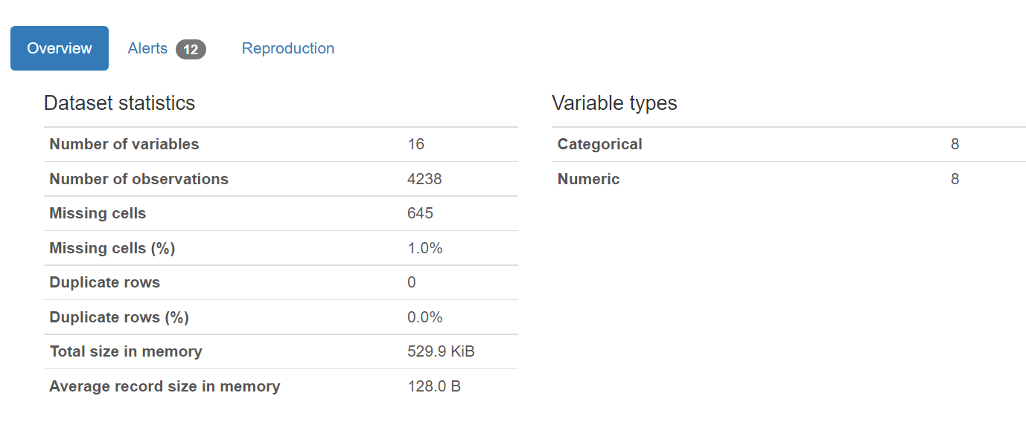
Analyzing Features using Visualizations

Slide 7
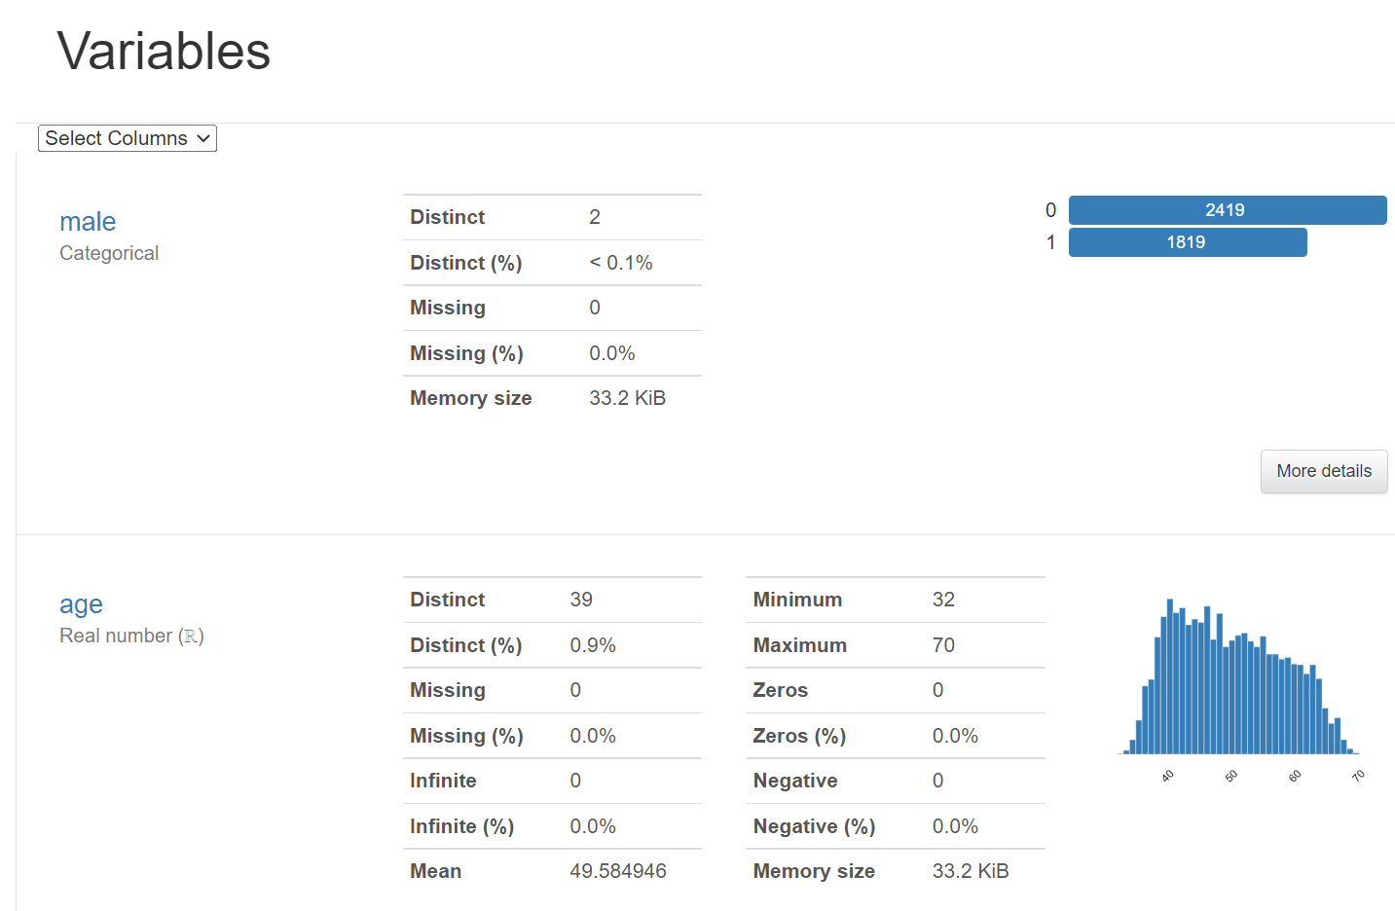
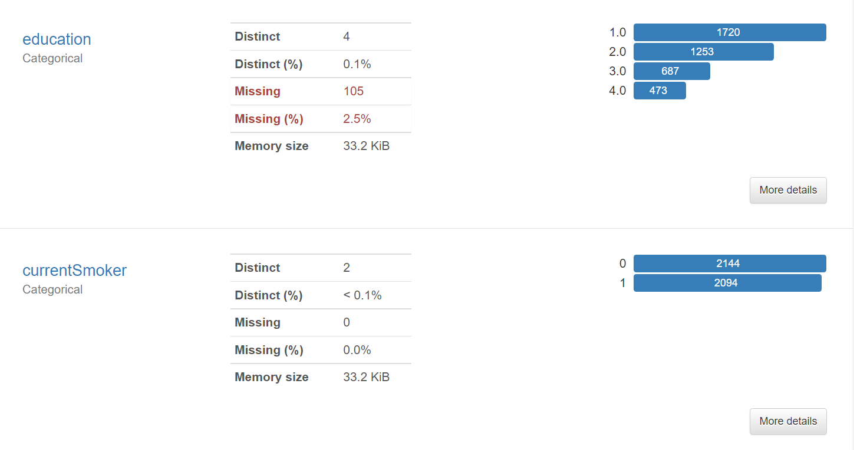
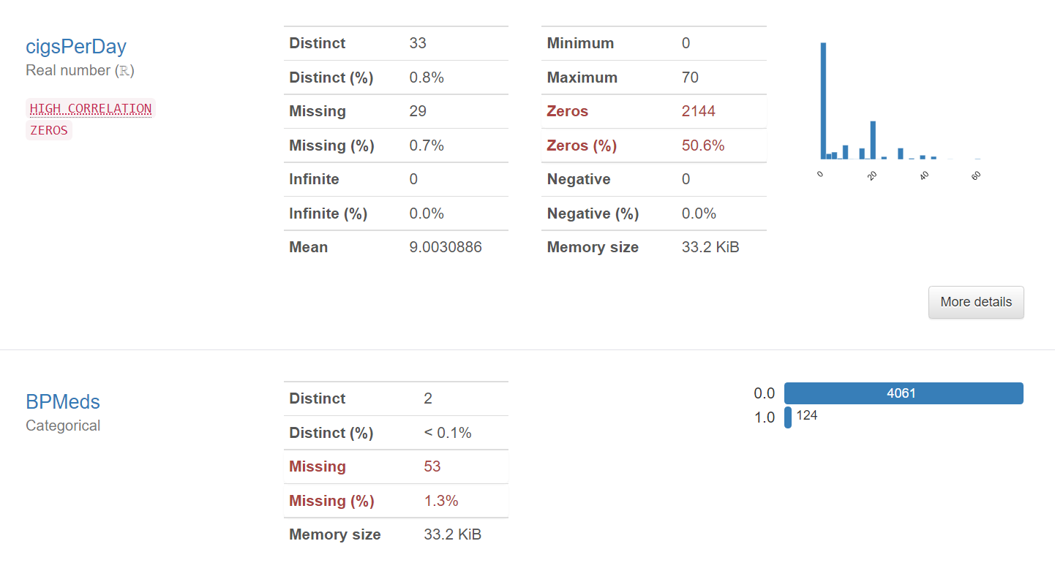
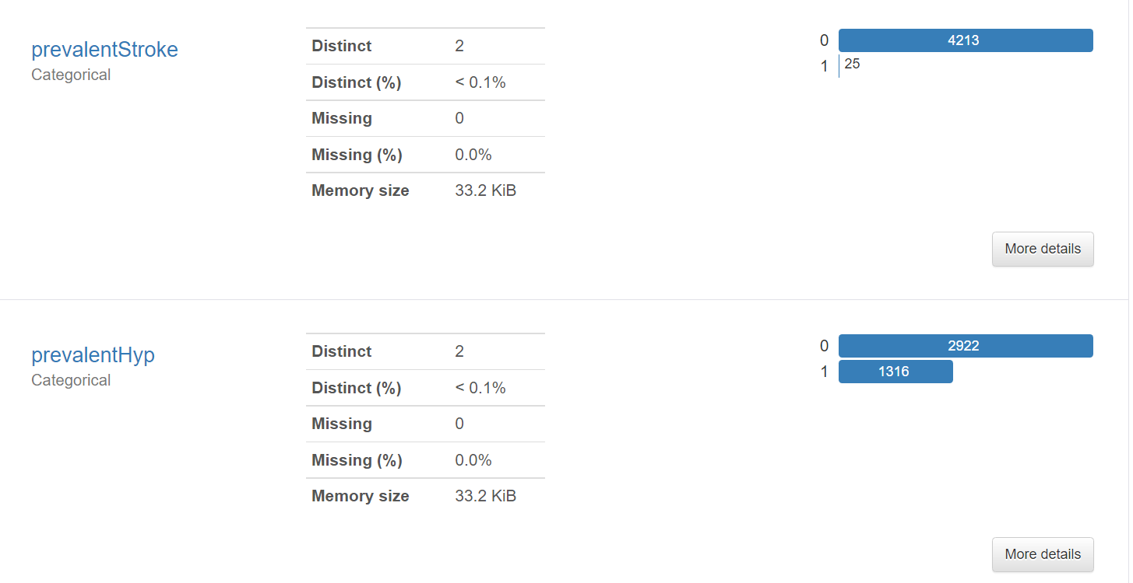

Slide 8
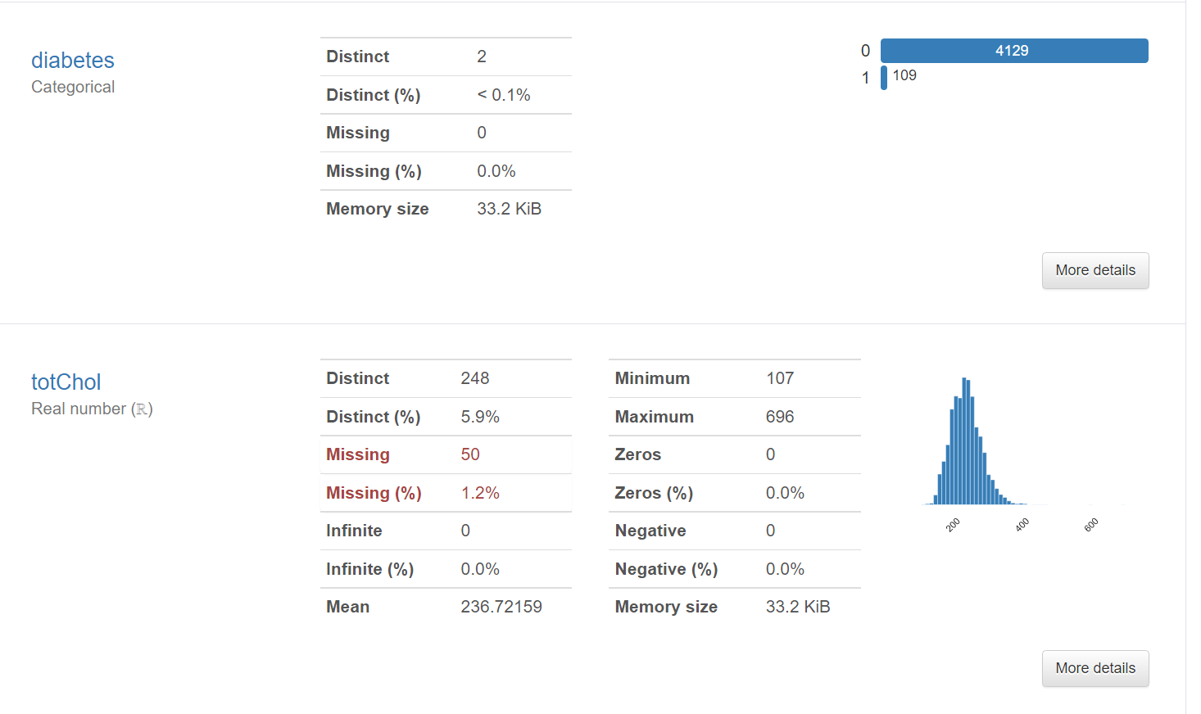
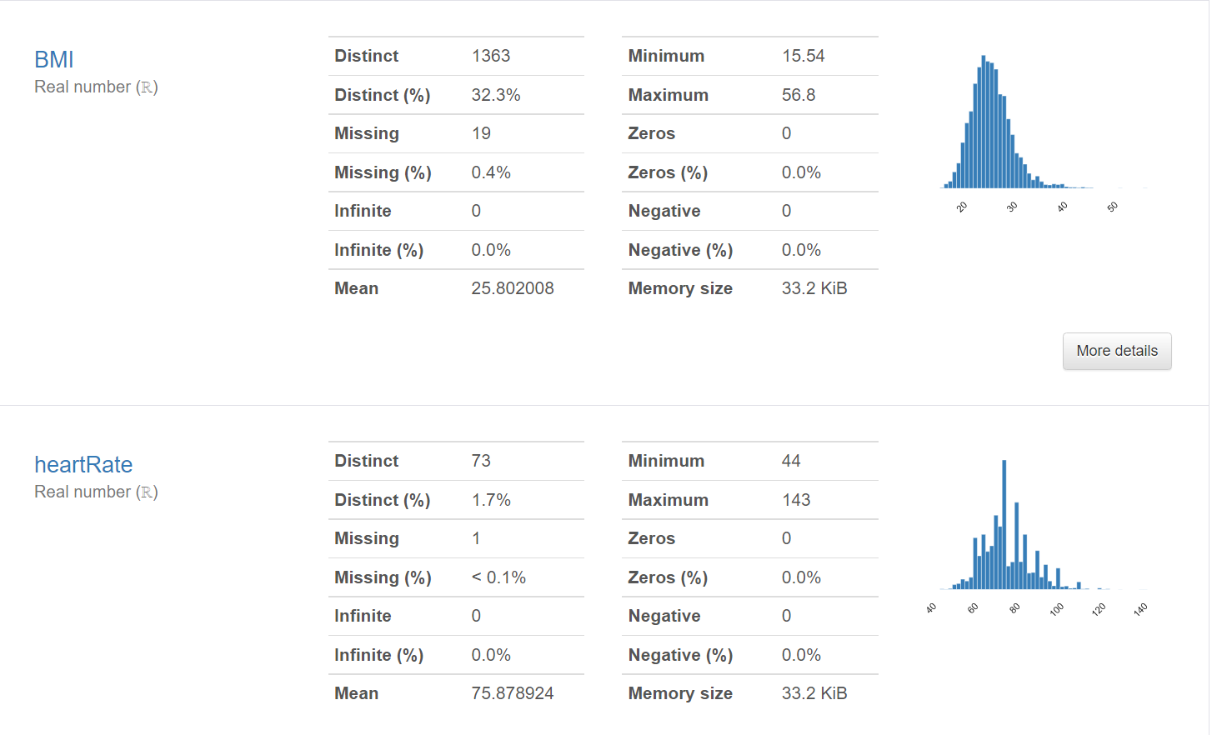
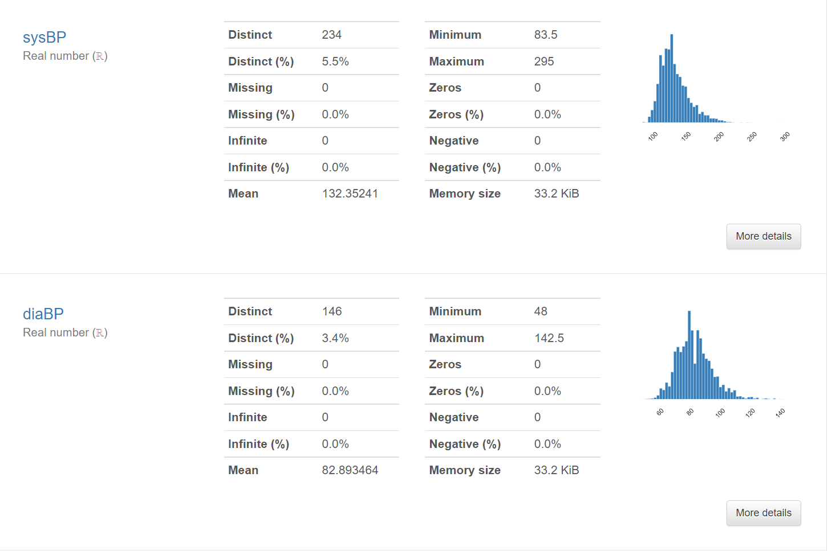
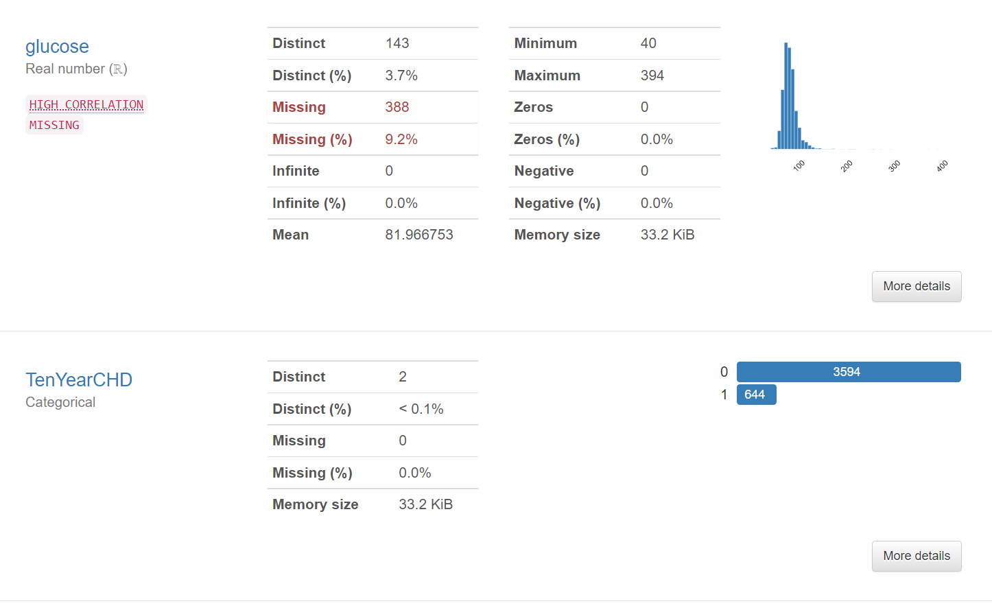

Slide 9
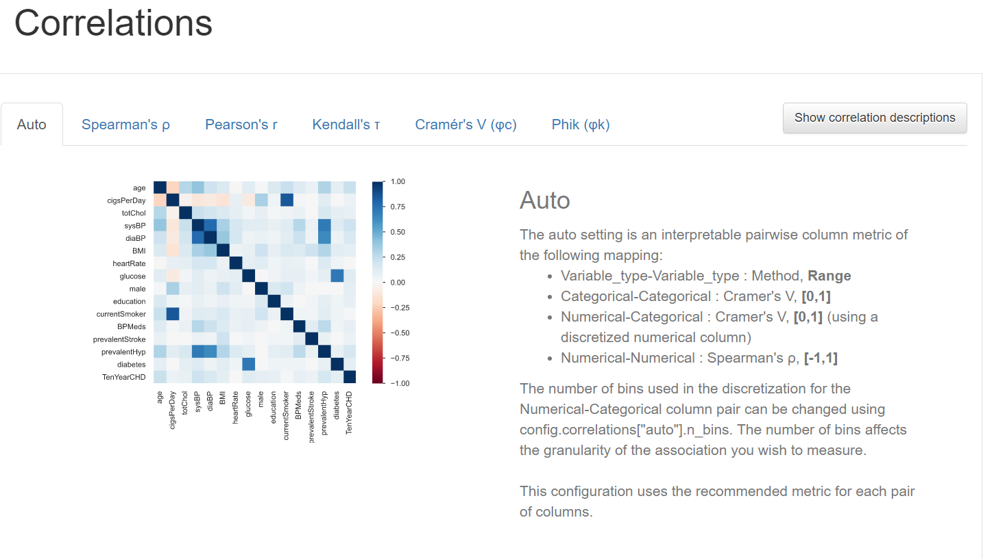

Slide 10
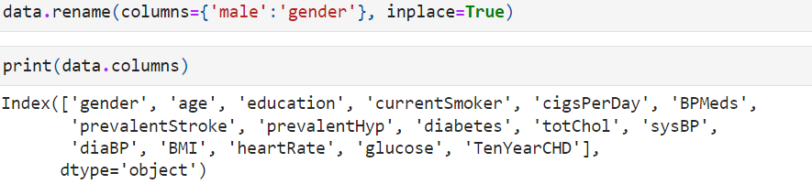
Data Cleaning
.
We have to find a way to effectively remove or replace the null values so that models can be applied.
The education column could be very subjective, has many null values and has no correlation to the other feature, so I'm going to drop it.
Here I want to change the column name Males as gender
And here Gender as 0 = Female; 1 = Male

Slide 11
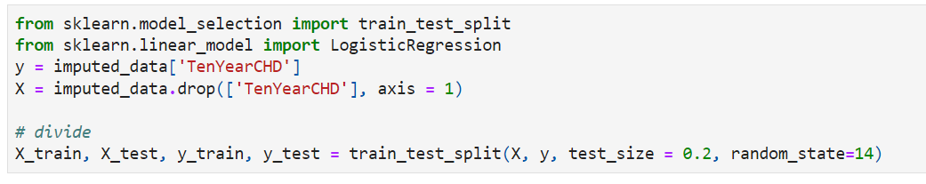
Data Distribution
To test the models' accuracy, we must set aside some training data and some testing data.

Slide 12
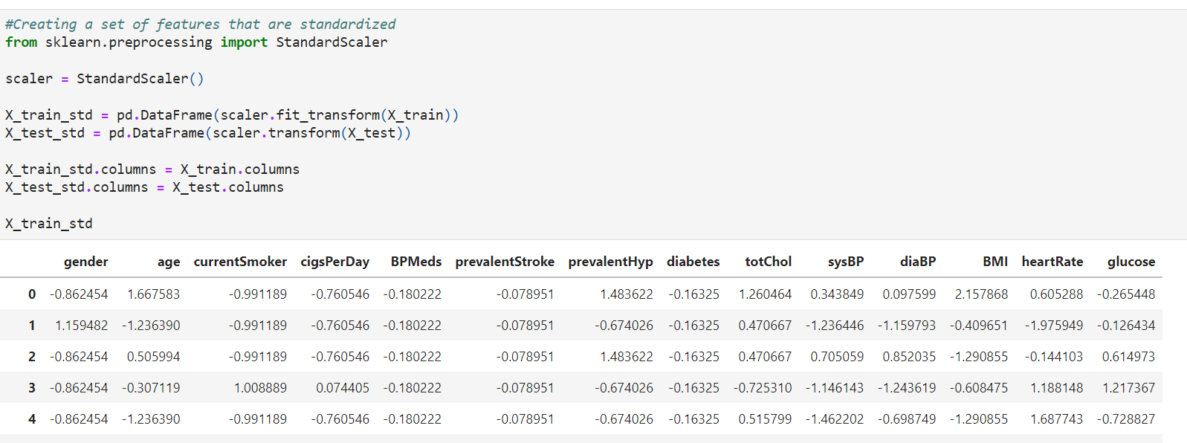
Standardization
Standardization is an important technique that is mostly performed as a pre-processing step before many Machine Learning models, to standardize the range of features of input data set.

Slide 13
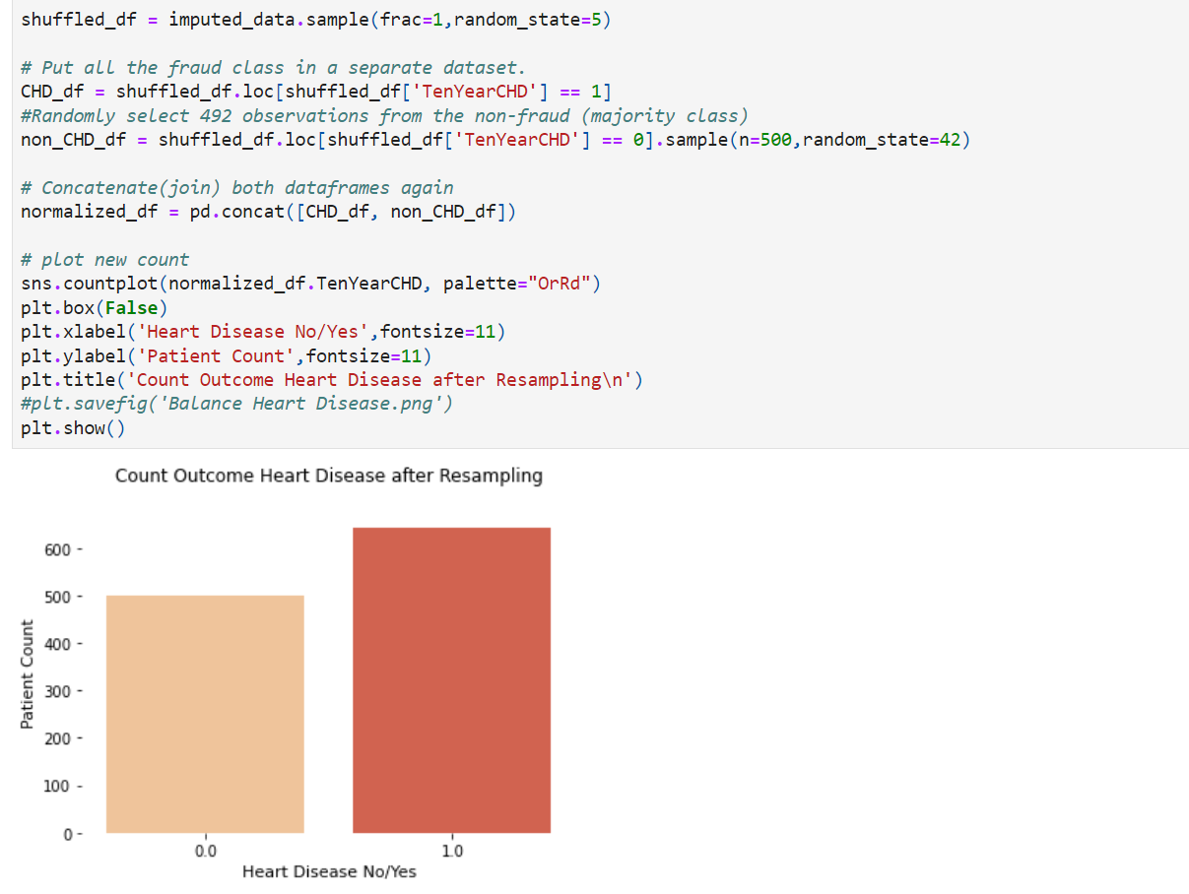
Normalization
Normalization is a data preparation technique that is frequently used in machine learning. The process of transforming the columns in a dataset to the same scale is referred to as normalization. Every dataset does not need to be normalized for machine learning.

Slide 14
Without a thorough analysis of this data, models will be more likely to predict that a patient does not have heart disease. The unbalance will be resolved by splitting training and testing data and then balancing the training data. To ensure that the training data is balanced, I will undersample to balance the training data.
When you get to the model training section, you may notice that I don't use these normalized values for training. I tried using the normalized values and the 4 types of accuracies were almost around the same percentages, which is good, however all the accuracies were between 50%~70%. So, I decided to not use the normalized data.

Slide 15
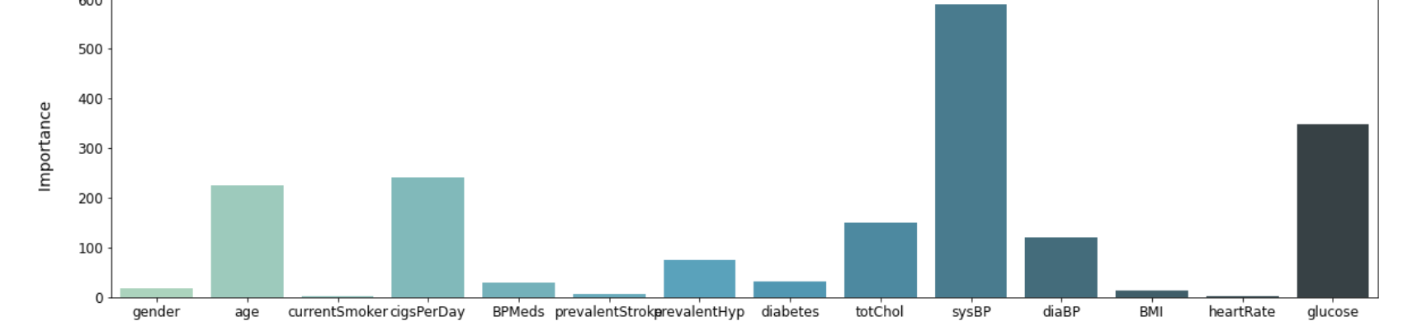
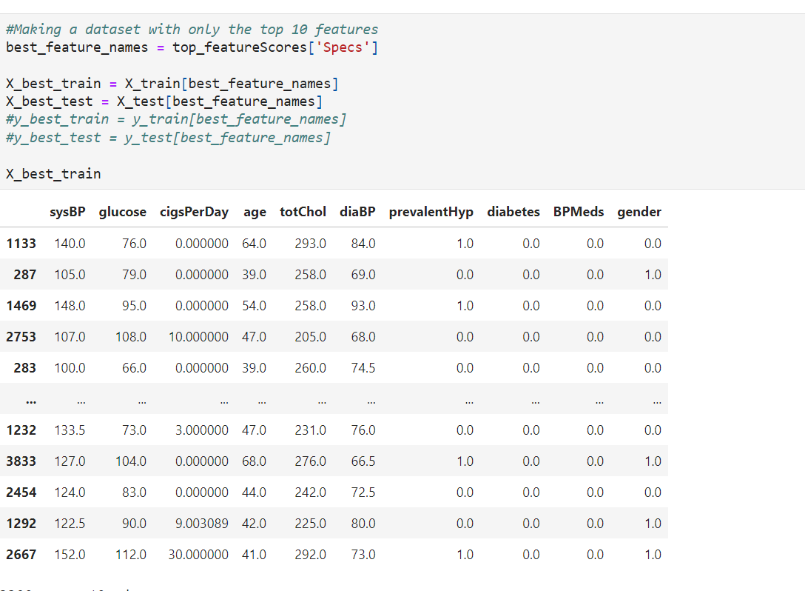
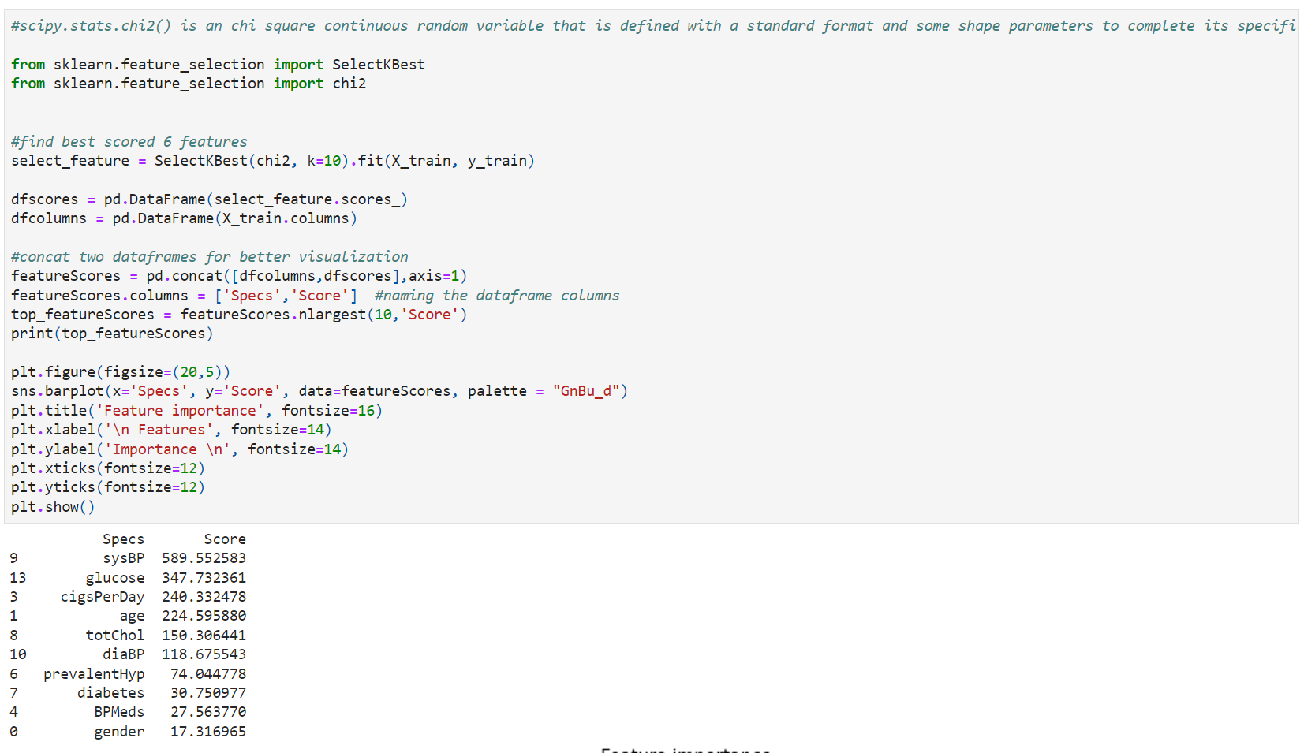
Feature selection

Slide 16
Applying Models
The models used:
Linear regression
Random forest
KNN

Slide 17
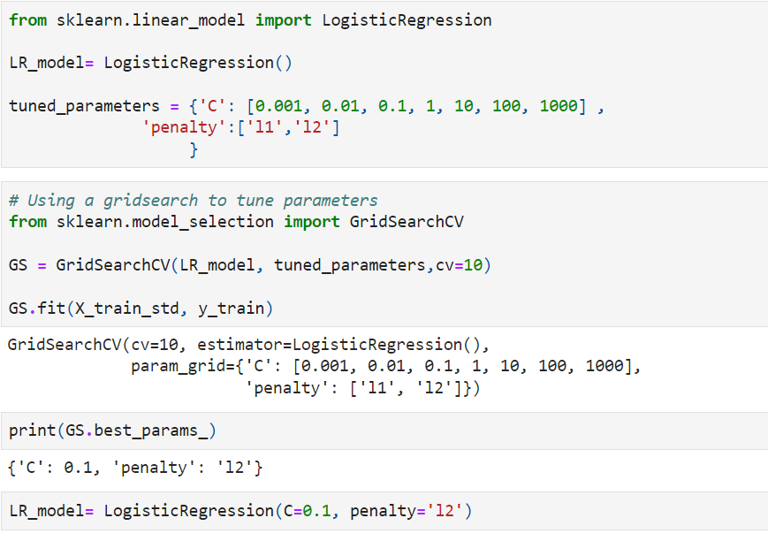
Logistic Regression
Tuning the parameters of the model:
The benefits of parameter tuning include increasing your model's accuracy, decreasing its runtime, and lowering its cost. Models from sklearn [2] and other libraries will have parameters that differ; however, these common algorithms have a considerable amount in common.

Slide 18
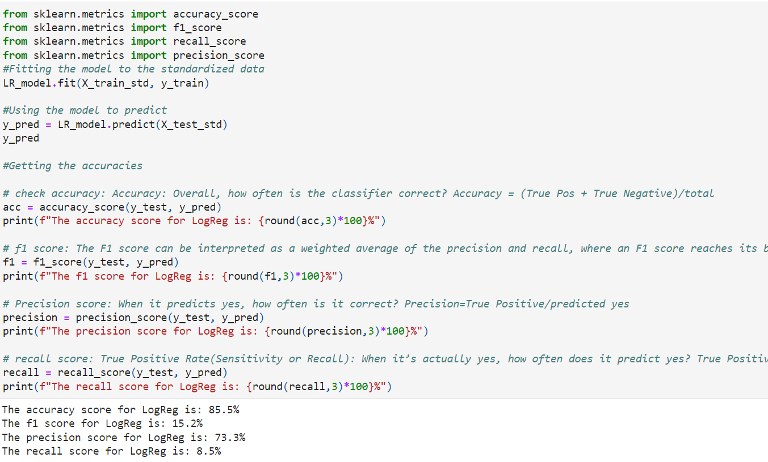
Standerdaised Prediction

Slide 19
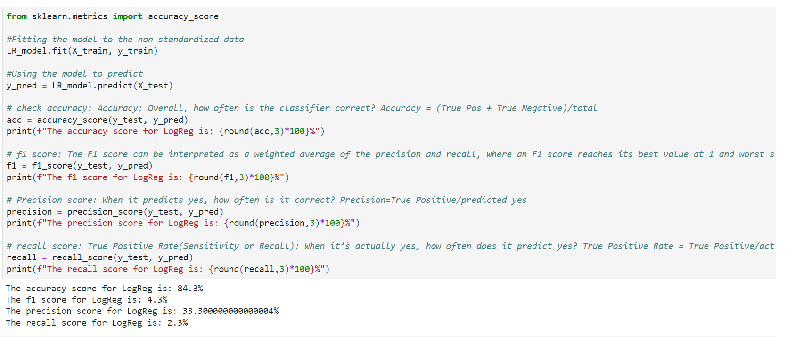
Non Standardized data

Slide 20
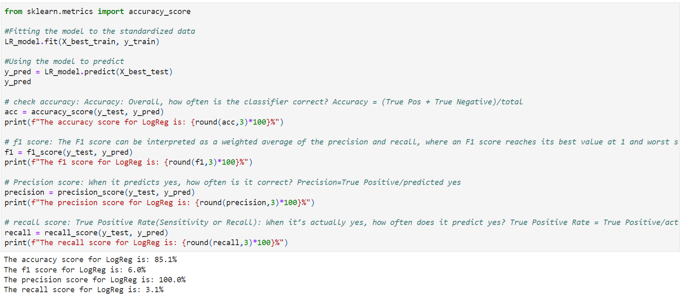
Limited Feature Model
The standardized data has a slightly higher accuracy and the limited feature model has a lower accuracy than the standardized model. Overall, the full, standardized model predicts the best with linear regression.

Slide 21
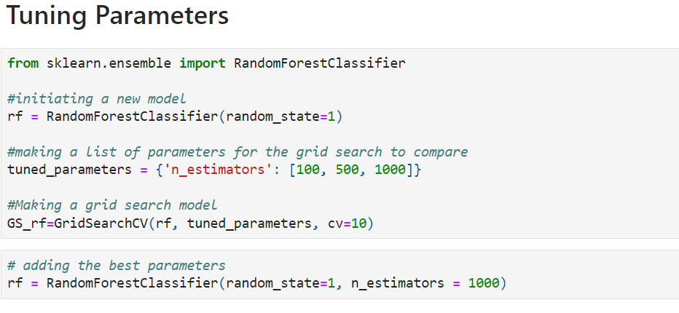
Random Forest
Random forest is a commonly-used machine learning algorithm trademarked by Leo Breiman and Adele Cutler, which combines the output of multiple decision trees to reach a single result. Its ease of use and flexibility have fueled its adoption, as it handles both classification and regression problems.

Slide 22
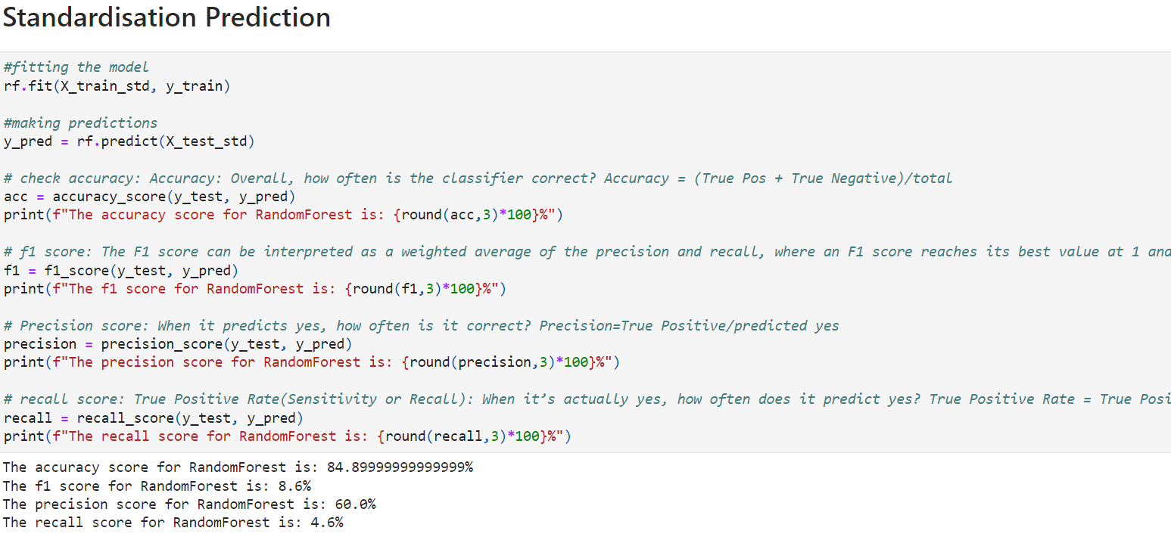

Slide 23
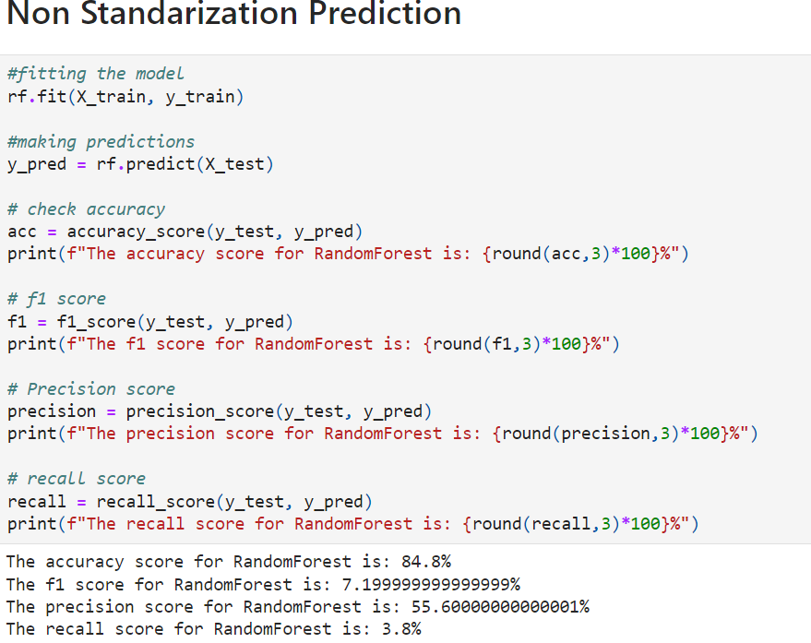

Slide 24
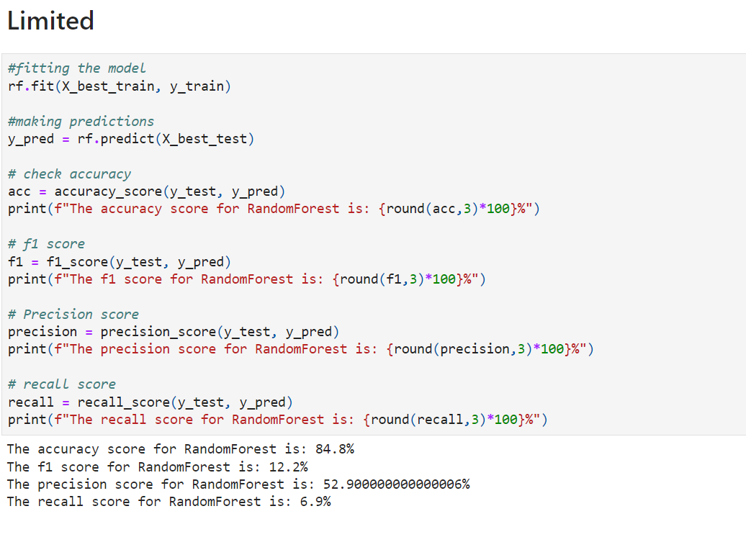

Slide 25
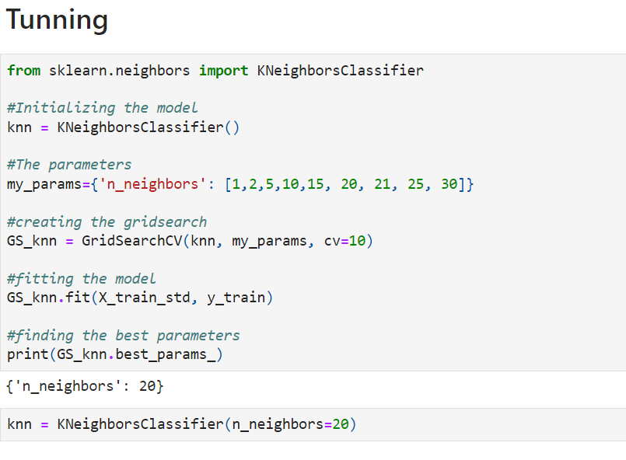
KNN
It is one of the simplest algorithms in Machine Learning. This algorithm is a supervised algorithm. The main function of this algorithm is to identify new items or cases by checking older items or cases in data set. Mainly it checks whether the new case has some similarity with older cases which is available in data set, or not. This algorithm can be used in both regression and classification techniques of Machine Learning. But it is mainly used in classification cases. This algorithm is a non parametric algorithm because it does not build any assumptions by underlying data. We know for every model there is training stage where the model learns about the method of prediction but for KNN algorithm the training phase is quite different. In training phase it only takes the data set and when new cases arrive then it stores them by checking older data set. This algorithm is called as lazy learner algorithm because it does not learn fast from training data set. It only does action when there are new cases. For this reason it is named so.

Slide 26
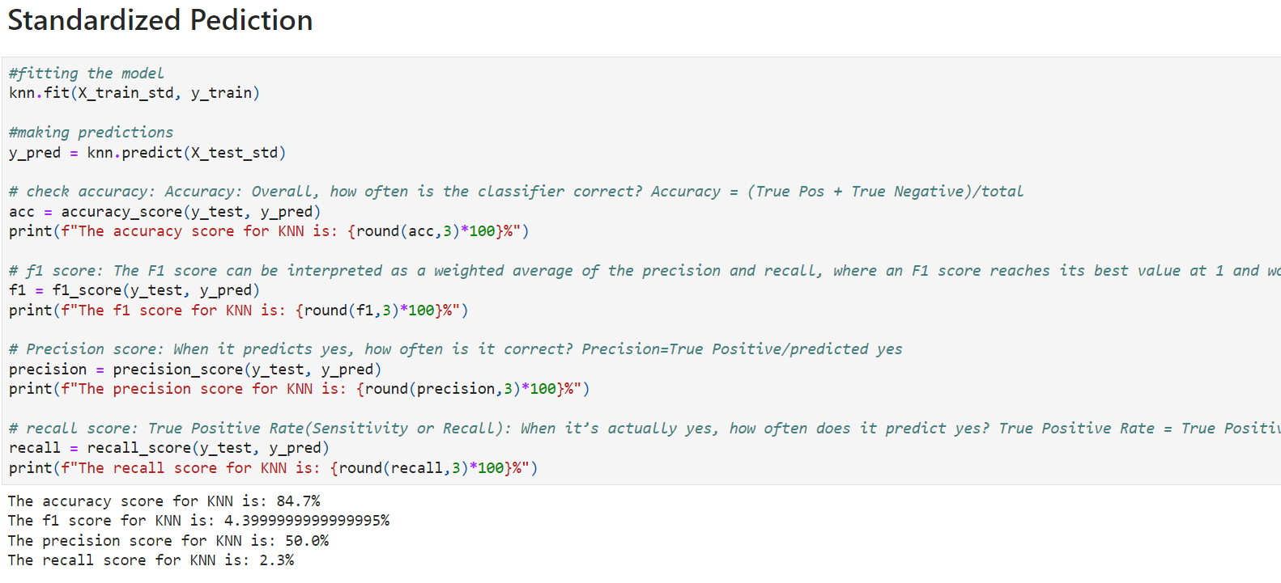

Slide 27
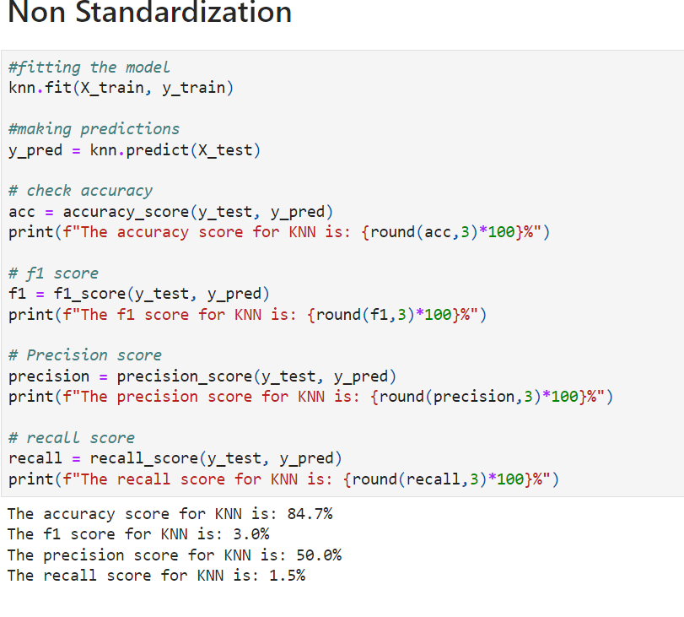

Slide 28
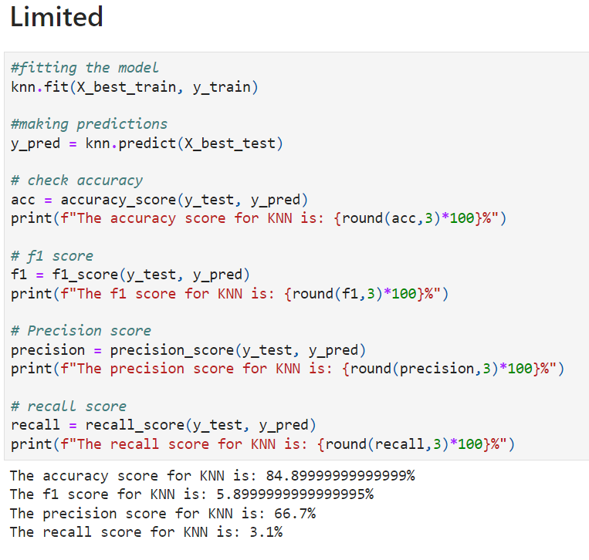
For the KNN model, the limited feature model has the highest accuracy and is overall the best model.

Slide 29
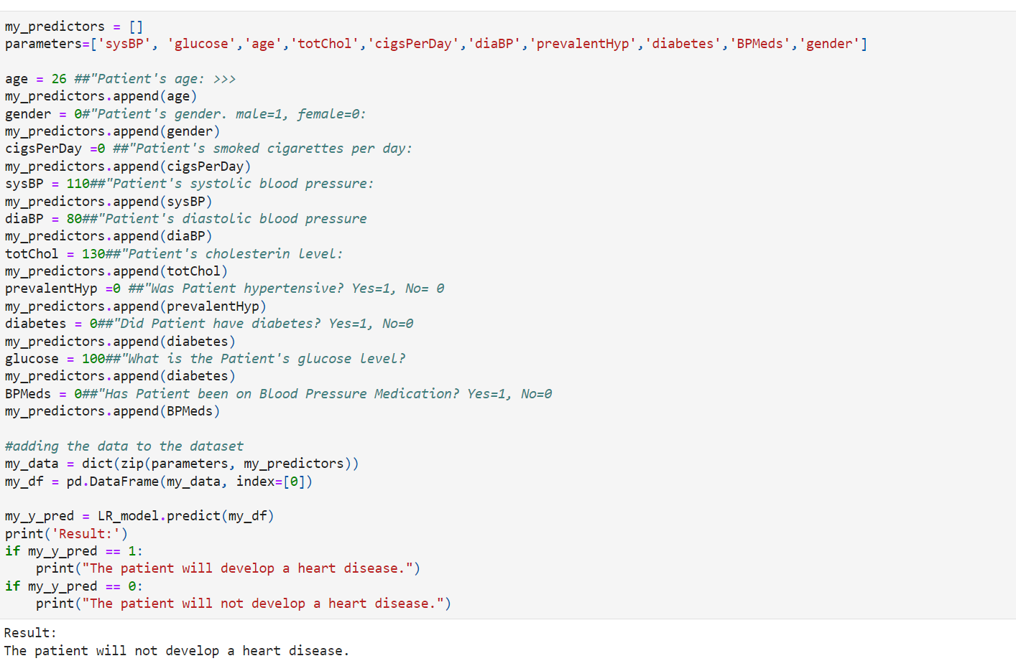
Will you develop CHD?
Enter you information as the variables to see if you'll get CHD. I've inputted my values (and average values for values I could not get at the moment)

Slide 30
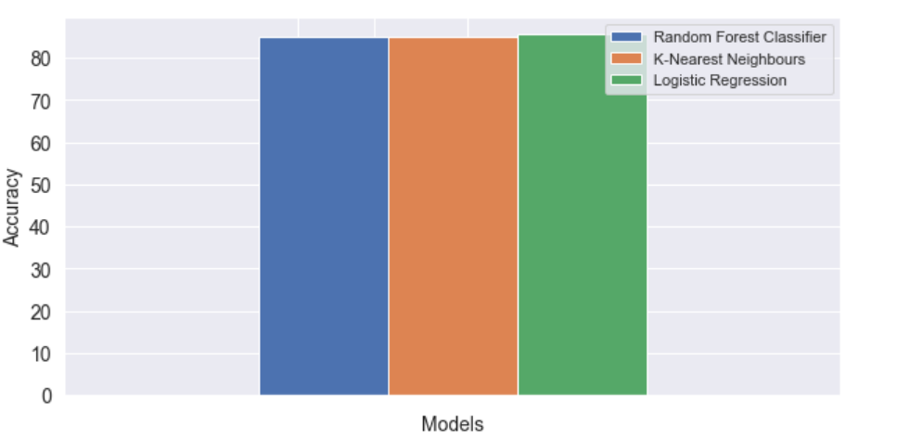
Conclusion
I'm going to compare the accuracies from the best of each model using a bar plot.

